Slide 1
Python final project
Document comparator

Slide 2
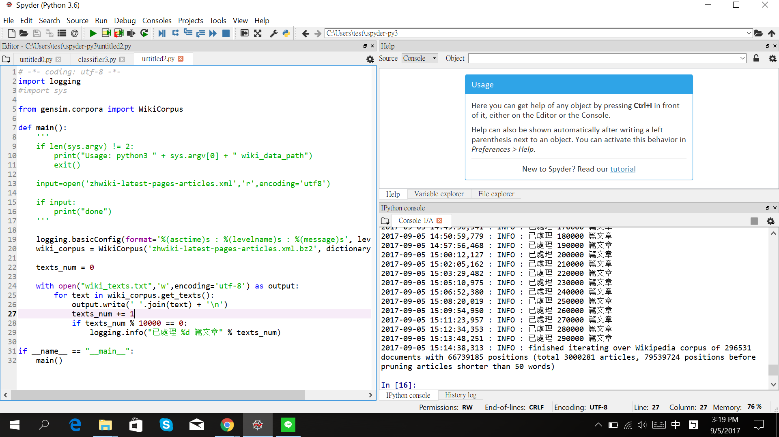
Document Crawler
中文:大約爬了300萬篇維基百科的文章
英文:大約包含1000億個單字

Slide 3
Basic idea

Slide 4
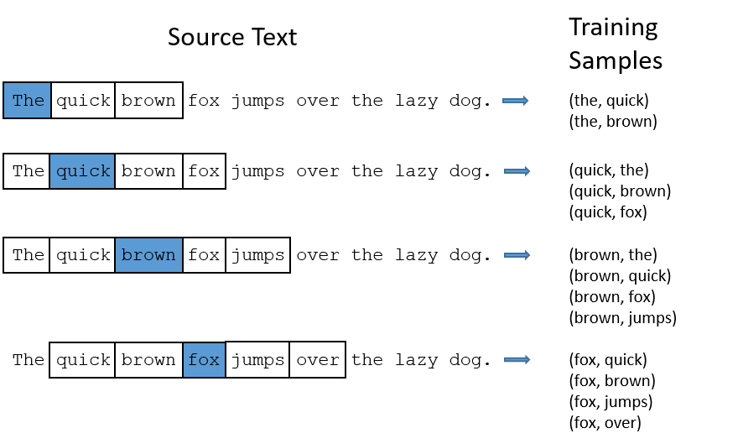
Use the sequence of the word to decide their relation

Slide 5
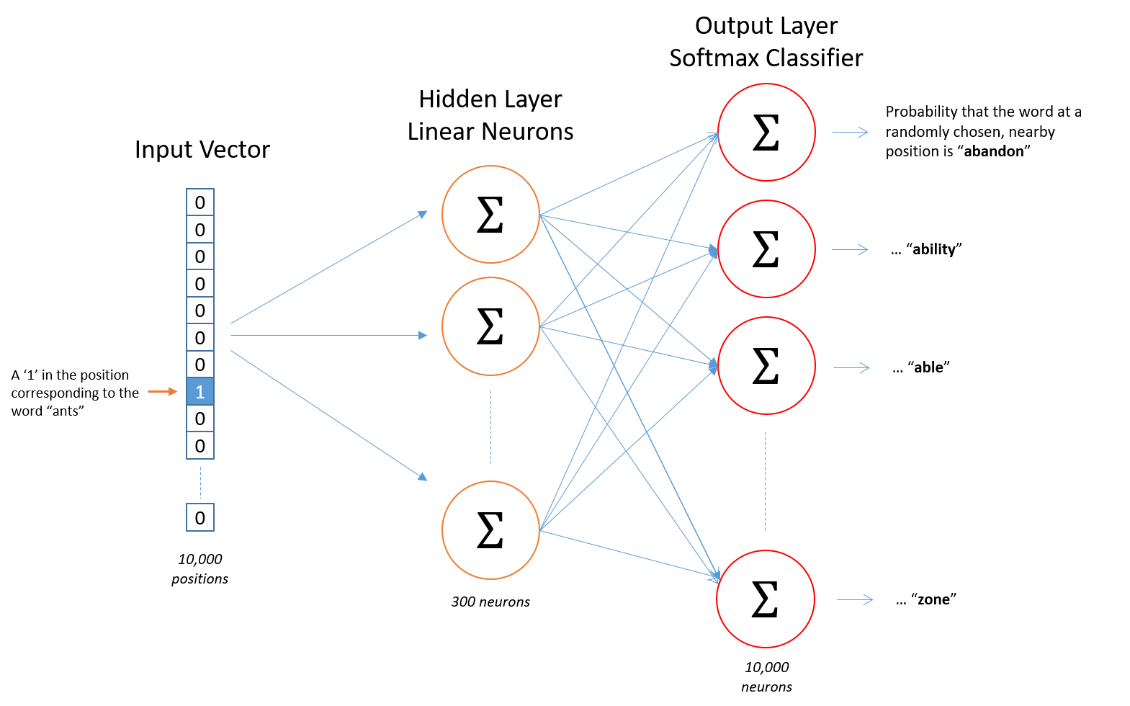
The architecture of the structure
Softmax regression
會使得輸出介於0與1之間，並且所有的輸出等於1

Slide 6

However, this is not enough!!!
Why?????

Slide 7
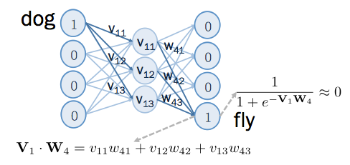
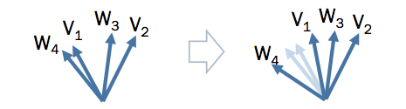
USE NEGATIVE SAMPLE TO ADJUST THE MODEL

Slide 8
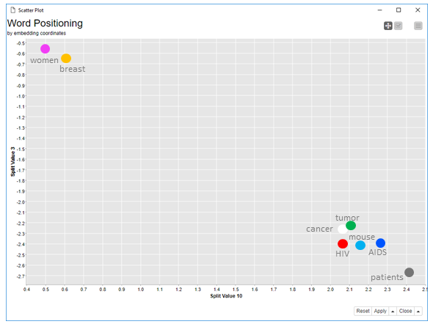

Slide 9
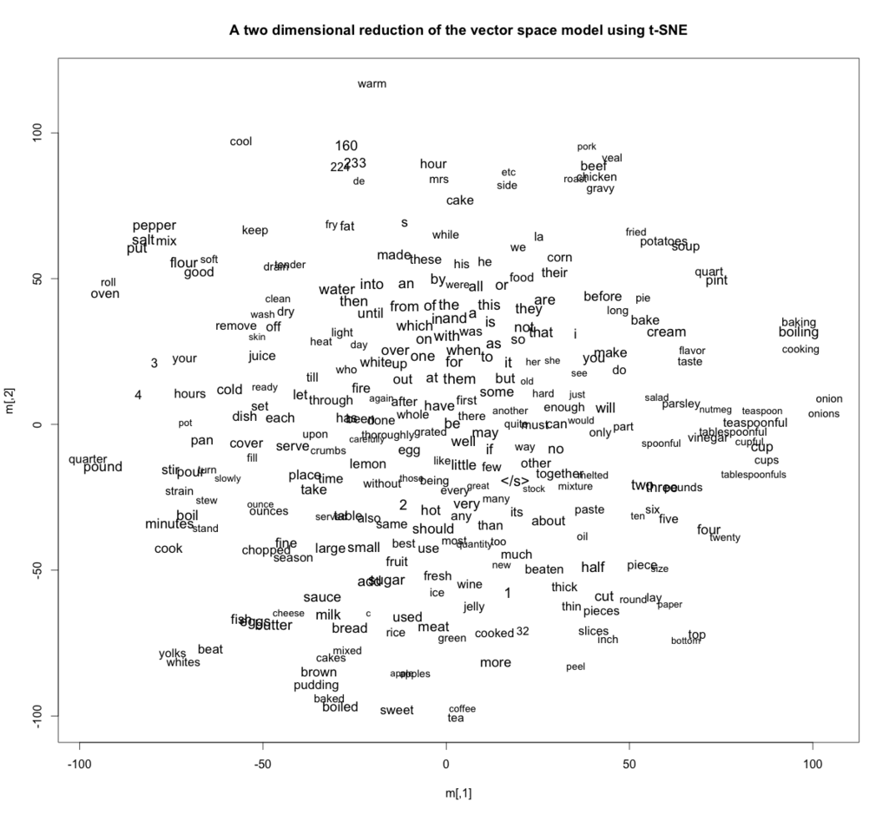

Slide 10
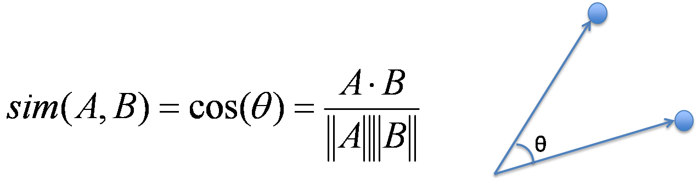
Document similarity:
Document’s vector=The add up of all the vectors of all the words in the document

